Slide 1
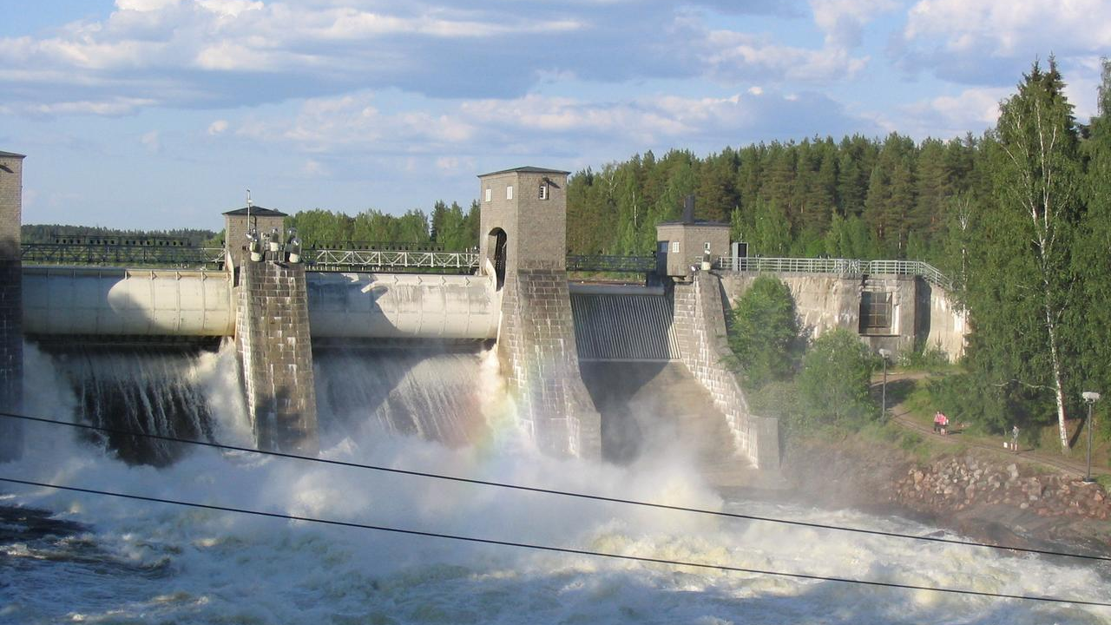
Automatic Dam Shutter Controlling System
Group-01
1706066
1706073
1706079
1706080
1706090
Presenting ID: 1706079

Slide 2
What is Dam?
A dam is a barrier that stops or restricts the flow of surface water or underground streams.
Reservoirs created by dams not only suppress floods but also provide water for activities such as irrigation, human consumption, industrial use, aquaculture, and navigability.
Dams generally serve the primary purpose of retaining water, while other structures such as floodgates or levees are used to manage or prevent water flow into specific land regions.

Slide 3
Components

Slide 4
Components List
Self Made Linear Actuator
i) DC Motor
ii) Screw
Two acrylic box joined and a hole inside
Acrylic Shutter / dam
Arduino UNO
Sonar
Motor Driver ( LM 298)
DC Supply

Slide 5
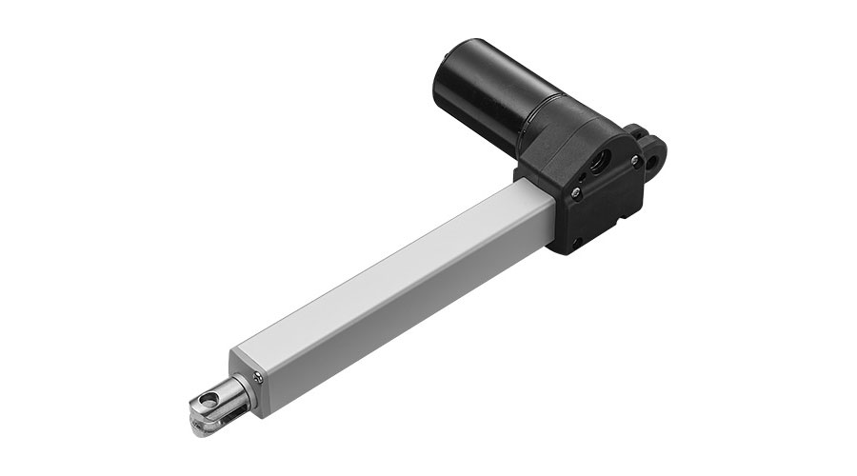
Construction of Linear Actuator
Presenting ID: 1706080

Slide 6
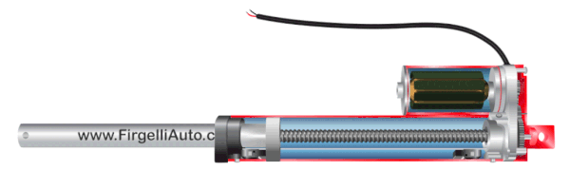
Construction of Linear Actuator
The basic working principle of electric linear actuators is to convert the rotary motion into a linear motion. This conversion of motion is done with the help of a gearbox and a lead screw. These are the two most important electric linear actuator parts.

Slide 7
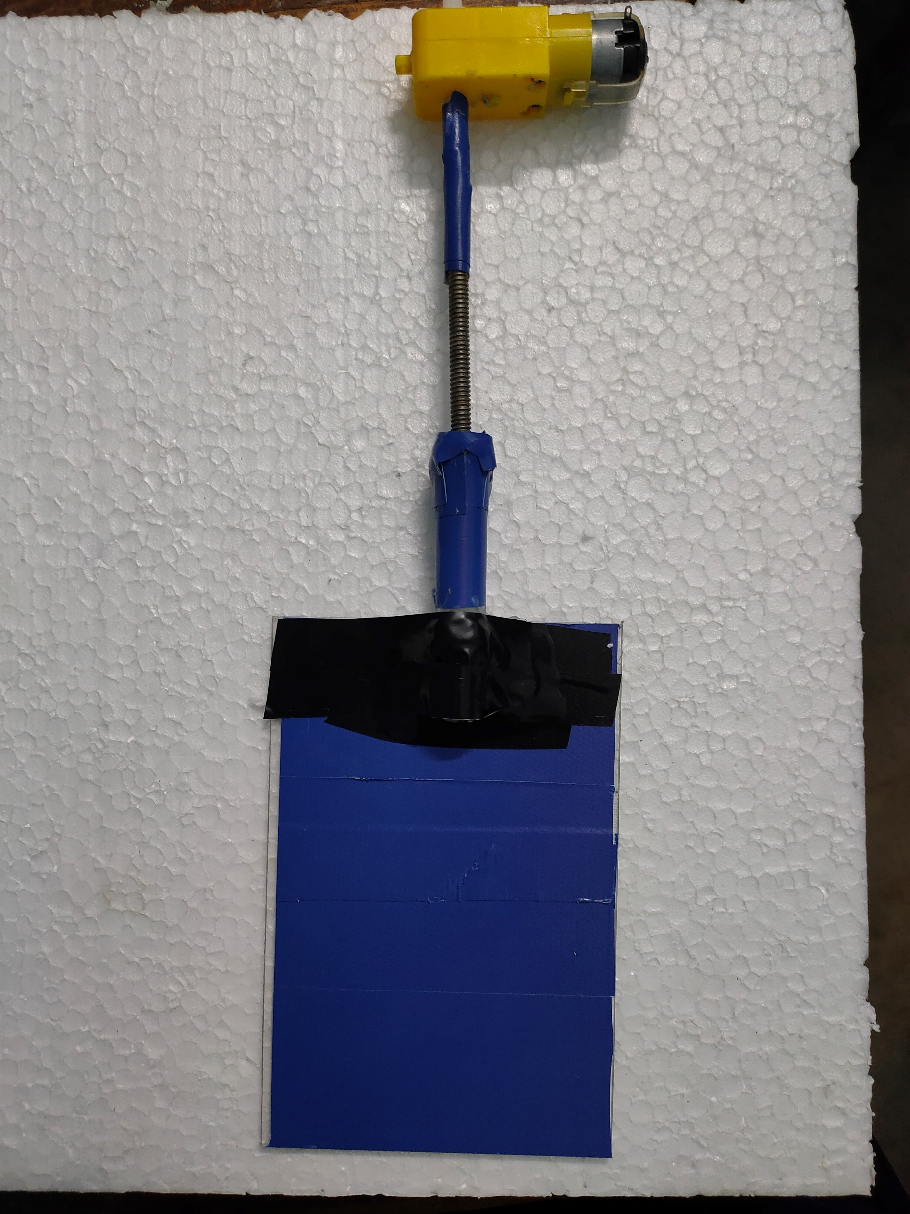
This the Linear Actuator we made

Slide 8
Working Principle
Presenting ID: 1706073

Slide 9
Dam Water
1) Water height of the dam is minimum 10 cm to open the shutter and 17 m to close the shutter

Slide 10
Dam Water
1) Water height of the dam is minimum xxx to open the shutter and xxx m to close the shutter
Sonar
2)Sonar will measure the water level and send it to arduino

Slide 11
Dam Water
Sonar
2)Sonar will measure the water level and send it to arduino
3) In Arduino code maximum, minimum water level
is provided to open or close the gate and then determining the polarity of voltage across the Actuator
Arduino

Slide 12
Dam Water
Sonar
3) In Arduino code maximum, minimum water level
is provided to open or close the gate and then determining the polarity of voltage across the Actuator
Arduino
Linear
Actuator
4) Motor will start to rotate after getting proper voltage . We have used a motor driver to ensure
best performance from actuator

Slide 13
Dam Water
Sonar
Arduino
Linear
Actuator
4) Motor will start to rotate after getting proper voltage . We have used a motor driver to ensure
best performance from actuator
Dam open/close
5) If water crosses the maximum height level dam will be opened and when water level decreases to certain level dam will be closed

Slide 14
Our Setup
Presenting ID: 1706090

Slide 15
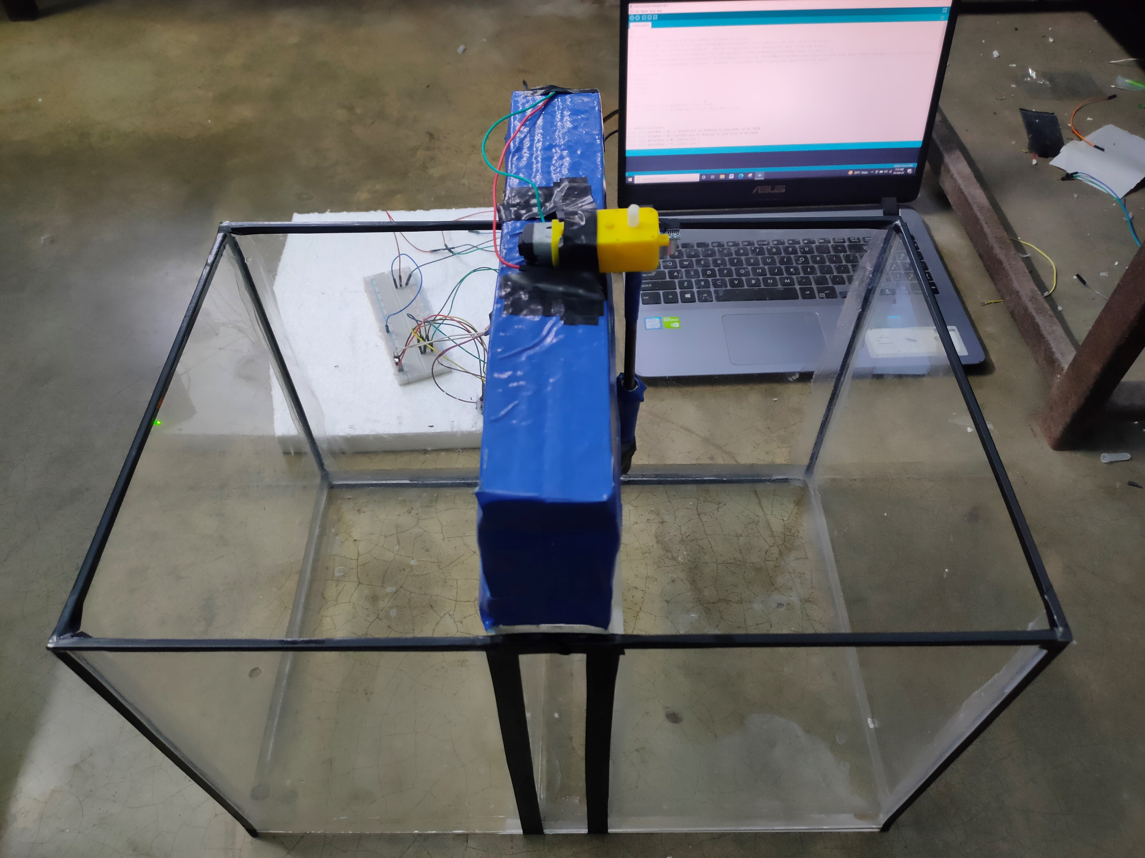
This is the full set up

Slide 16
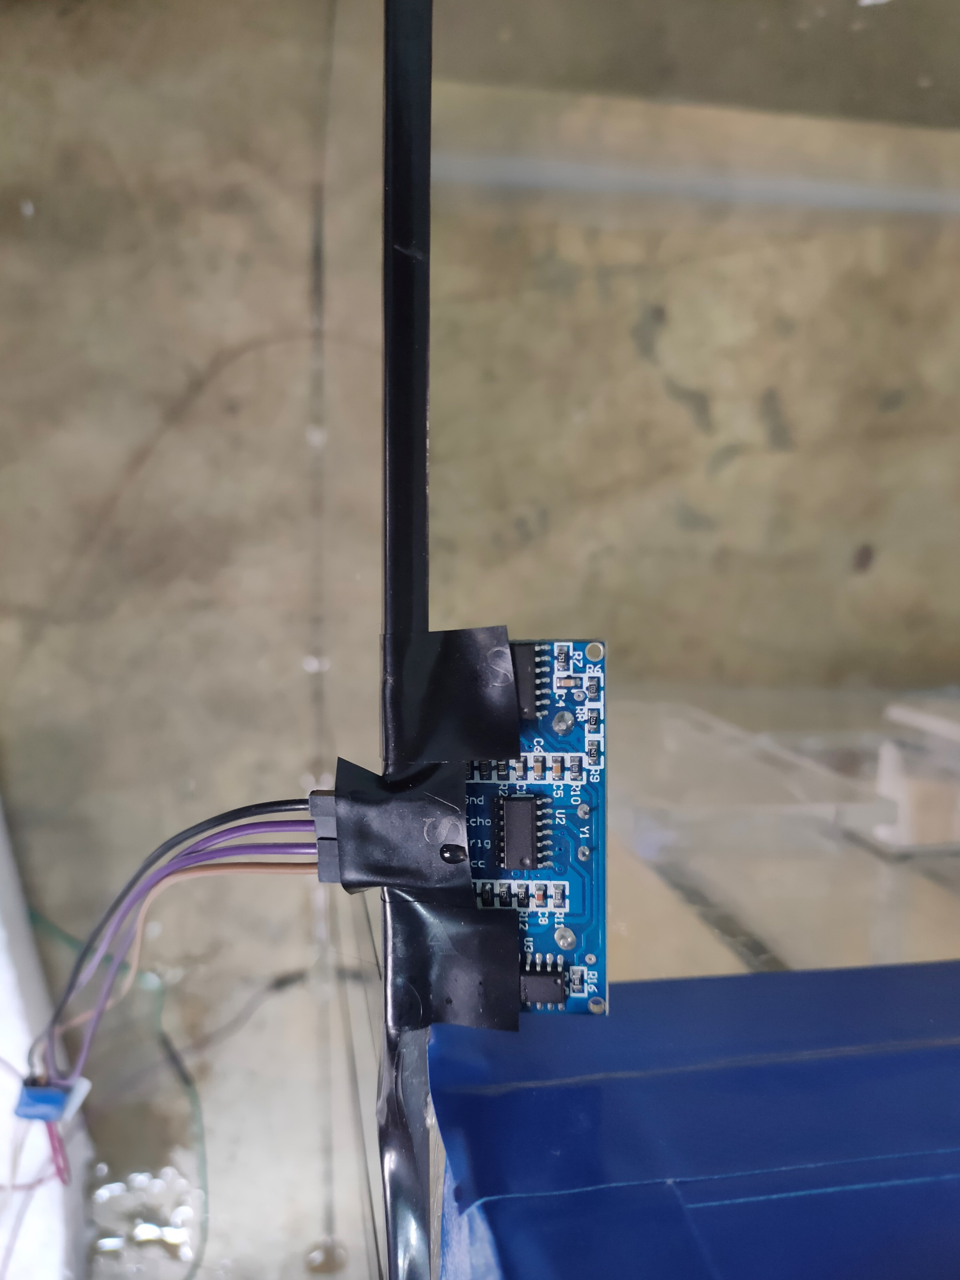
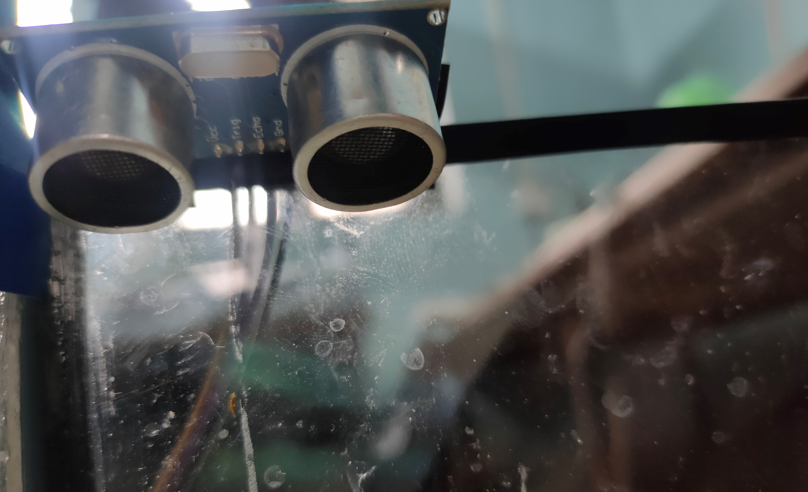
SONAR

Slide 17
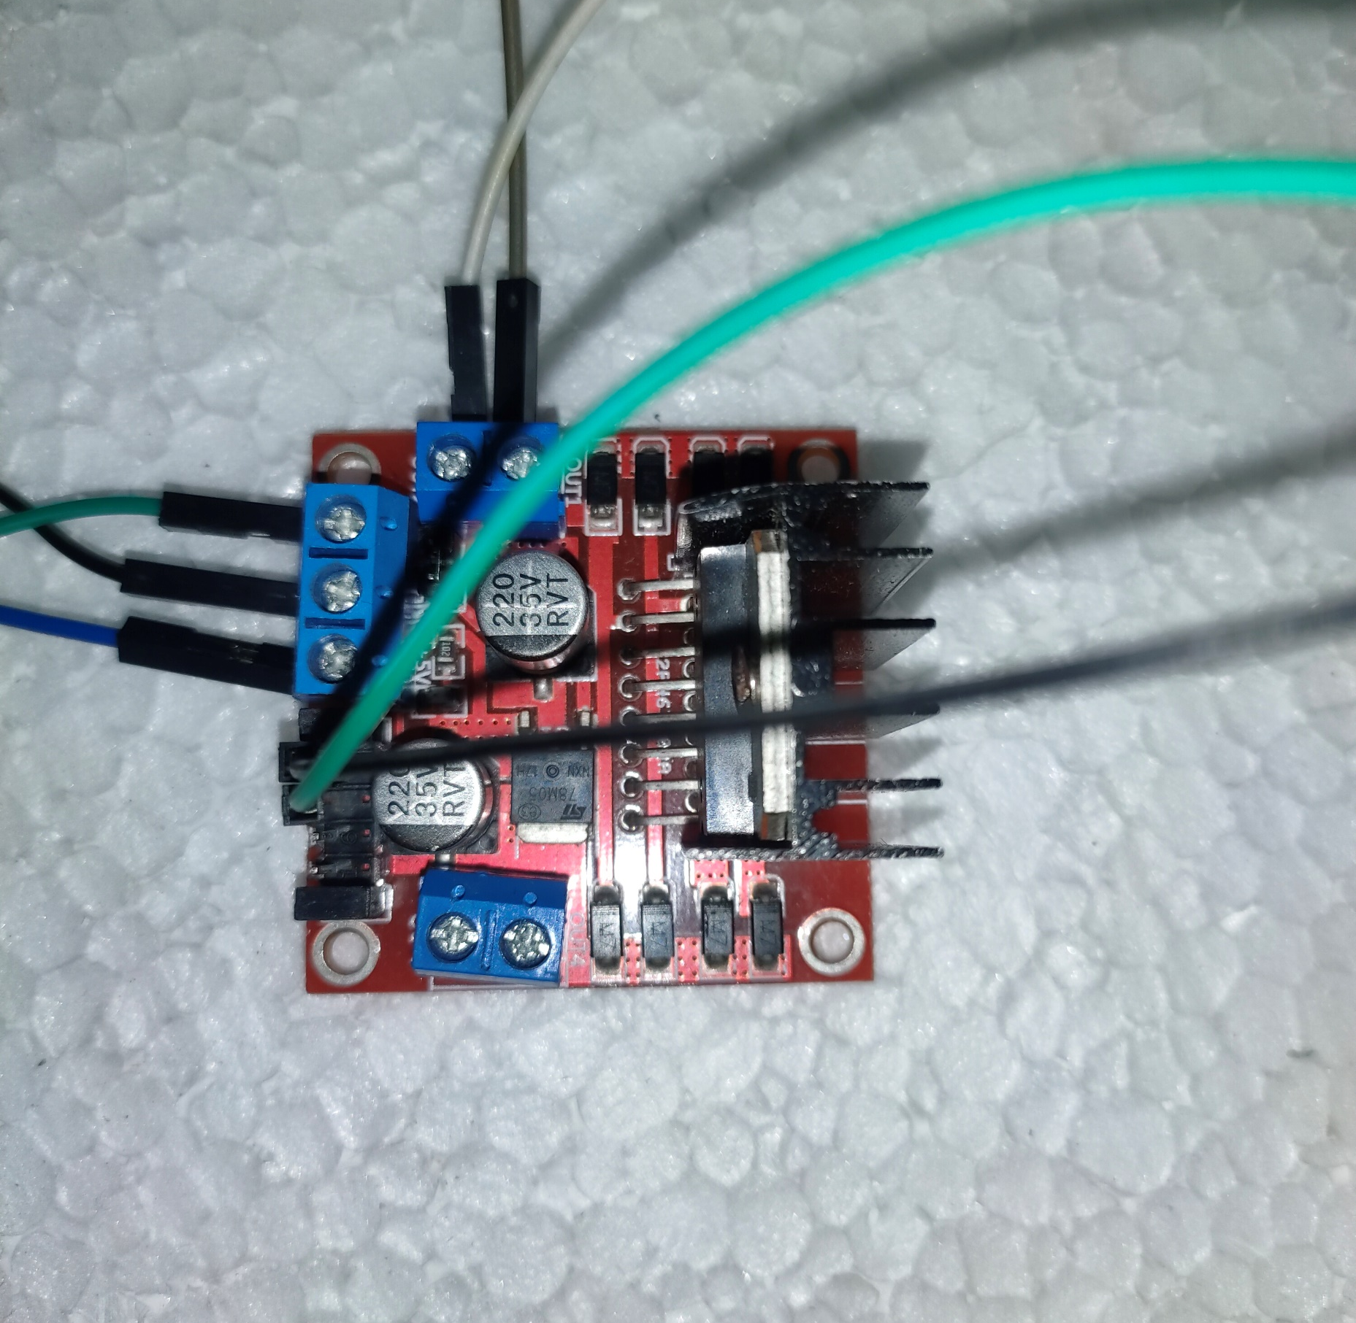
Motor Driver

Slide 18
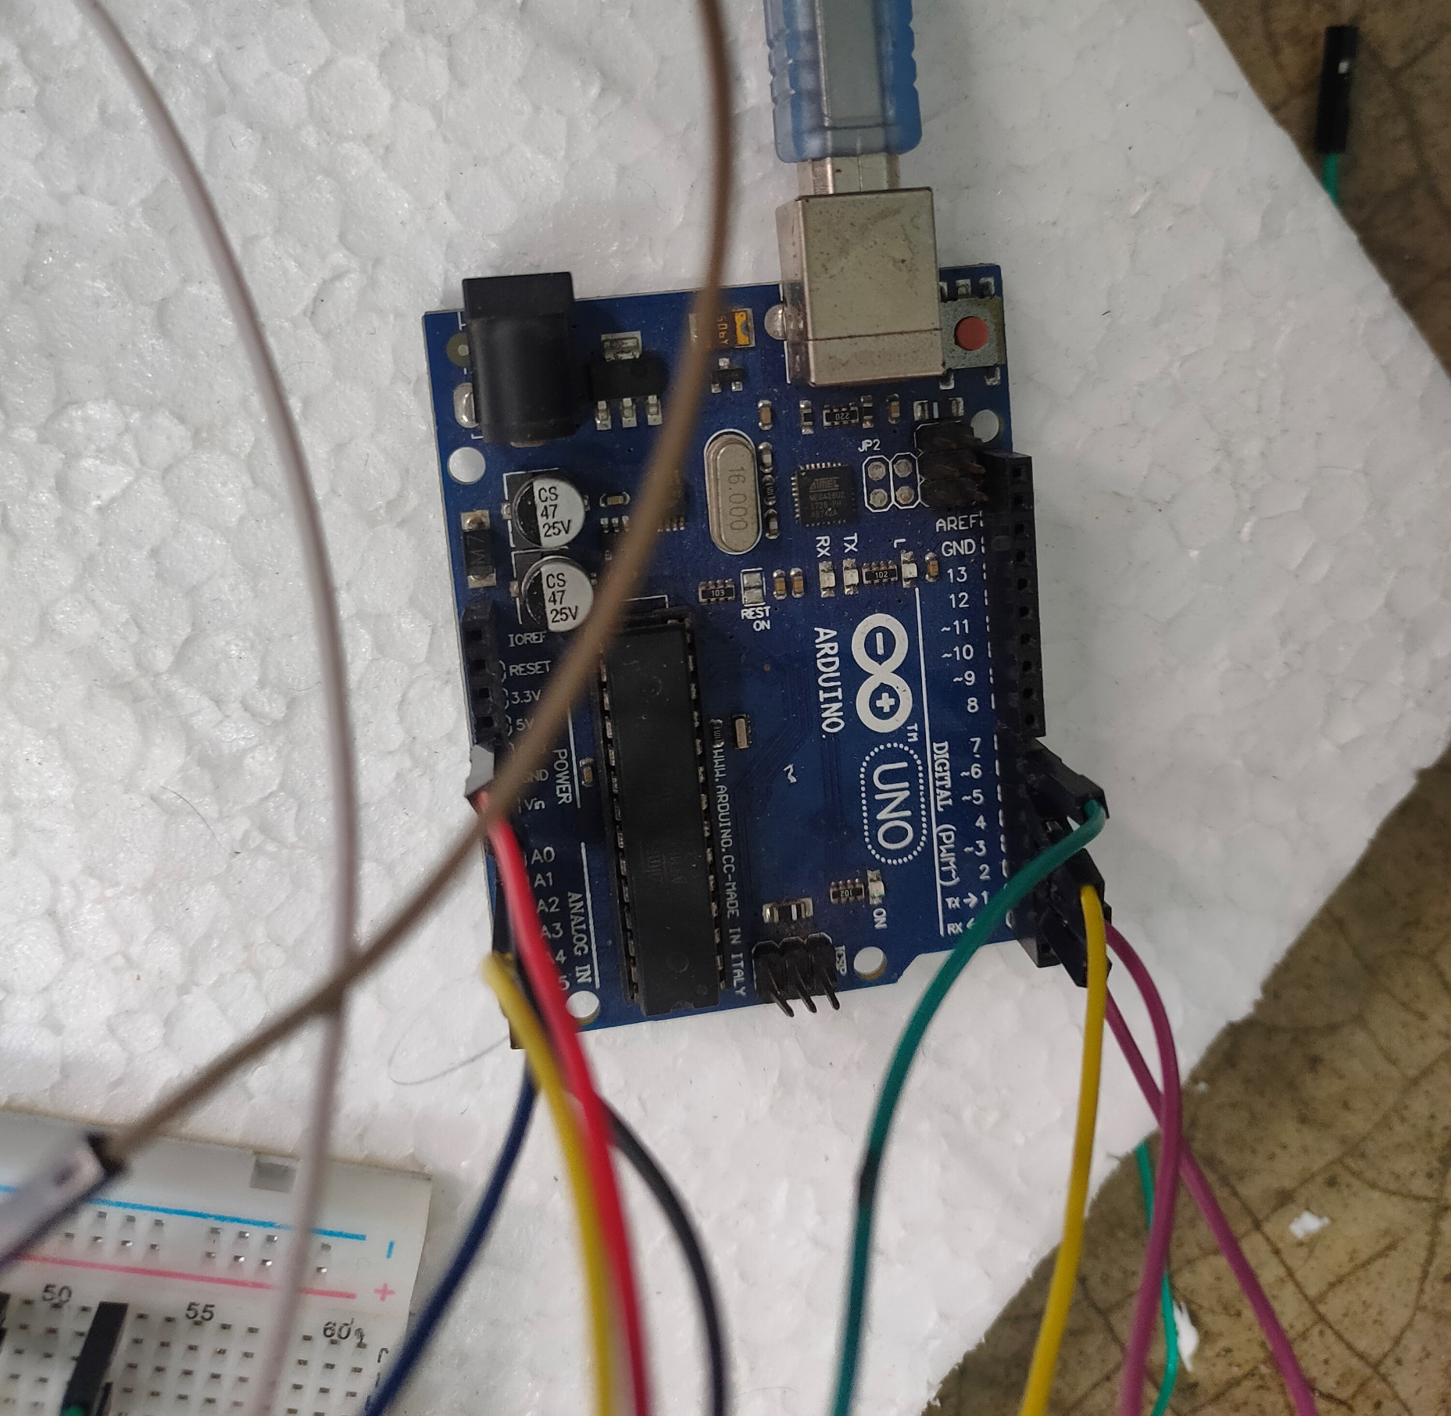
Arduino

Slide 19
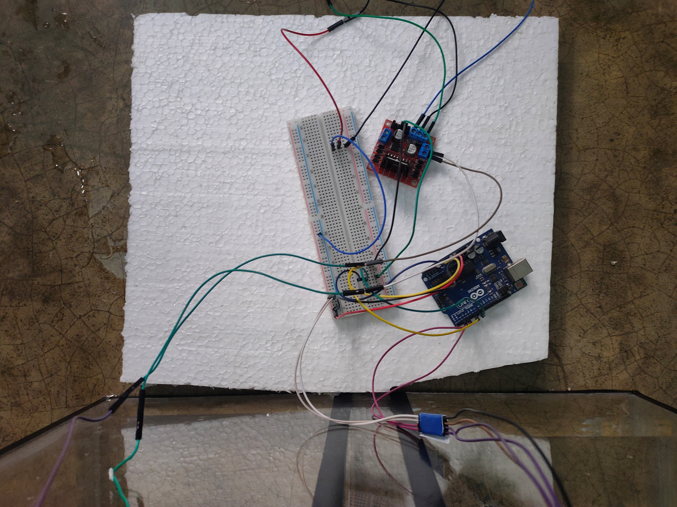
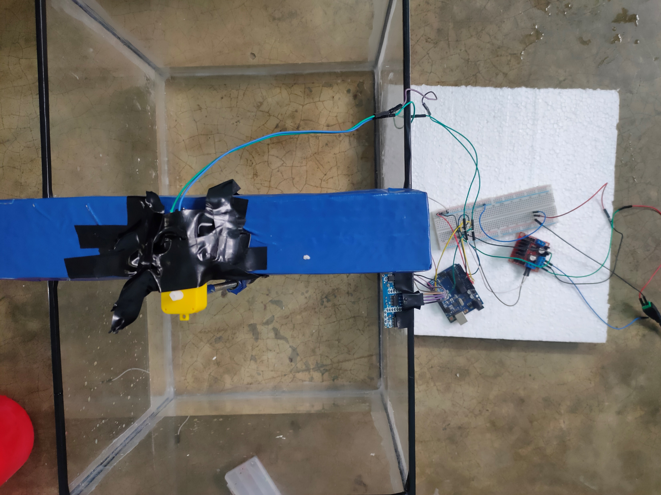
Circuit

Slide 20
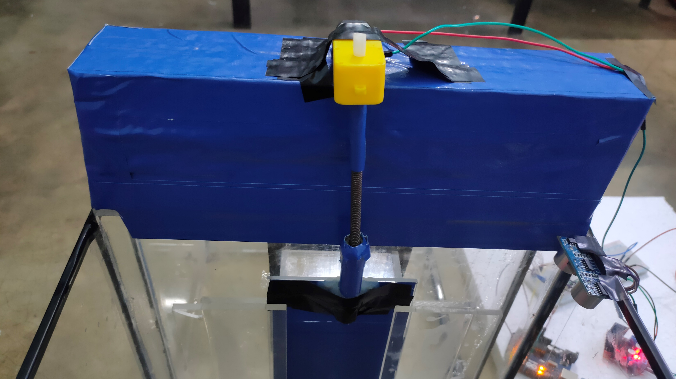
Dam Gate Controlled by Linear Actuator

Slide 21
Importance of water dam
Controlling Flood
Storing Water
Generating Electricity

